Slide 1

50.039 Theory and Practice of Deep Learning W2-S1 Neural Networks, Initializers, Optimizers and other Good Practices
Matthieu De Mari

Slide 2
About this week (Week 2)
What are the typical initializers for trainable parameters in Neural Networks?
What is symmetry in a Neural Network and why is it essential to break it with proper initializers?
What is the exploding gradient problem?
How to spot and fix an exploding gradient problem?
What is the vanishing gradient problem?
How to spot and fix a vanishing gradient problem?
Why are activation functions needed in Neural Networks?
What is the universal approximation theorem?

Slide 3
About this week (Week 2)
What are typical examples of activation functions? Which activations should I be using?
What are typical examples of advanced optimizers? (Adagrad, RMSProp, Adam, etc.).
How to implement said optimizers manually?
What is a stochastic gradient descent and what are its benefits?
How to implement the stochastic gradient descent manually?
What is a mini-batch gradient descent and what are its benefits?
How to implement the mini-batch gradient descent manually?
How to combine all optimizers concepts into a great optimizer?

Slide 4
About this week (Week 2)
What is the no free lunch theorem?
What is the train-test-validation split? Why is it good practice to use an extra validation set?
What is the early stopping of optimizer concept? Why is it good practice to use it?
What are saver and loader functions? Why is it good practice to use them?
What are other common good practices when it comes to Neural Networks?
How to decide on an appropriate number of layers and neurons?

Slide 5
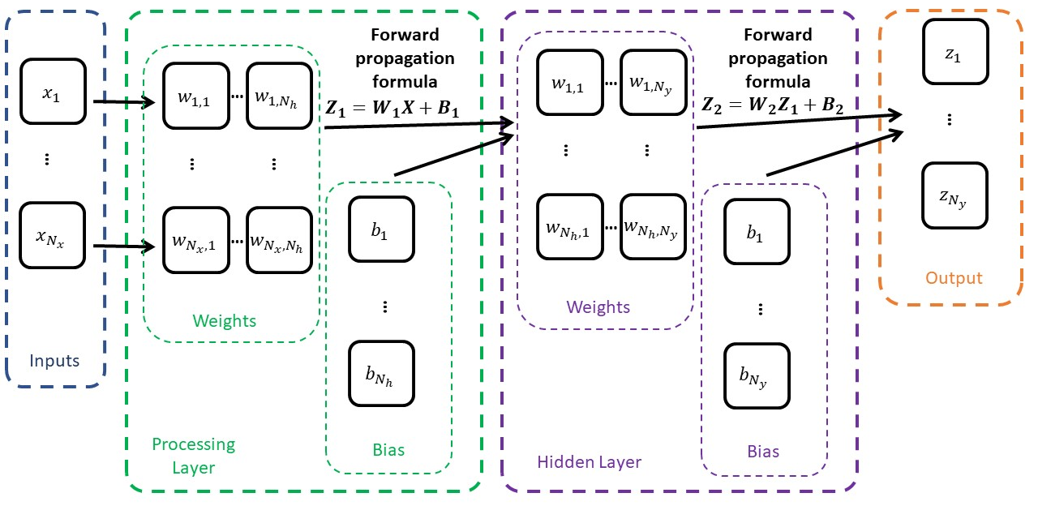
Our shallow NN with two processing layers

Slide 6
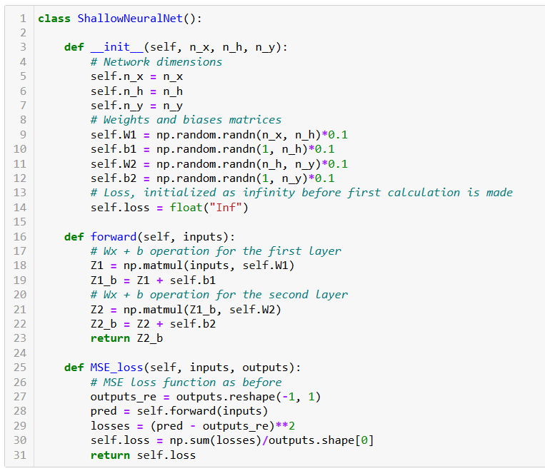
Our NN class
How it works:
Weights and biases matrices are now initialized as normal random with zero mean and variance 0.1.
Forward method for making predictions using current parameters.
Loss function for performance evaluation.

Slide 7
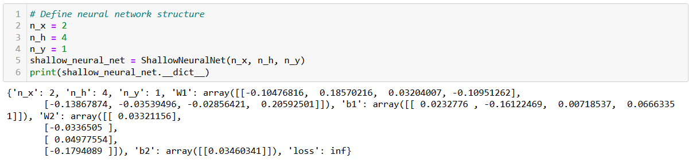
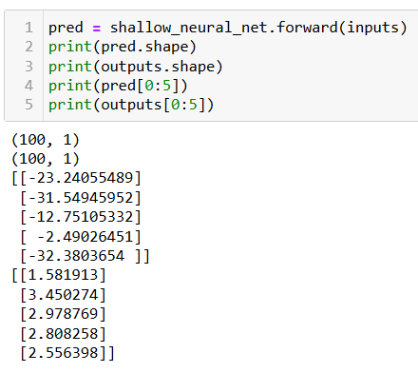
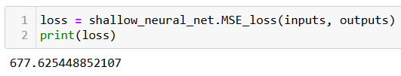
Initialize model
Forward to predict
Compute loss to evaluate model (it is bad, because trainable parameters have received random values!)

Slide 8
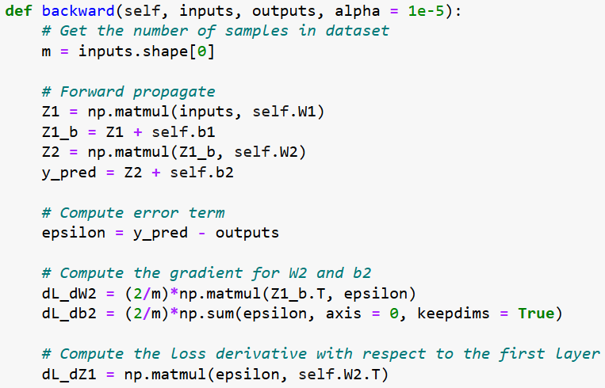
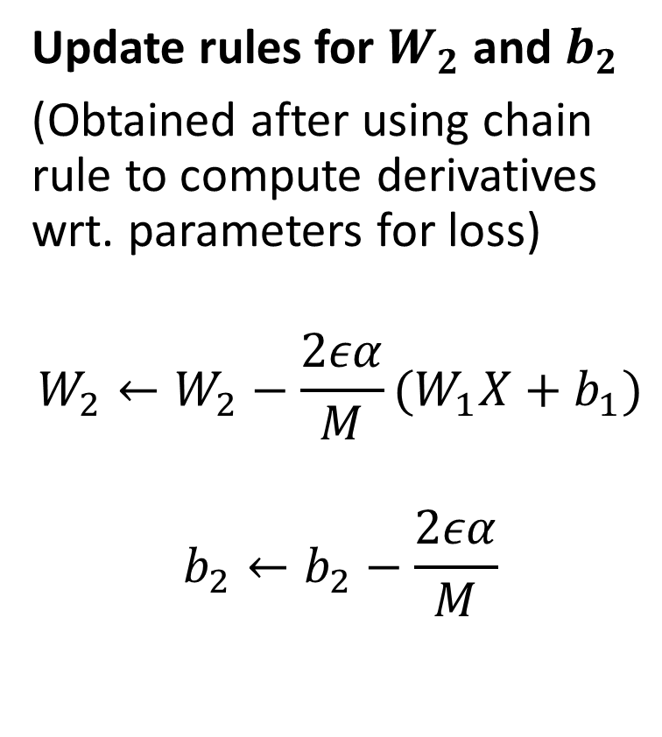
Backpropagation in our model
Update rules for $W_{2}$and $b_{2}$
(Obtained after using chain rule to compute derivatives wrt. parameters for loss)
$$W_{2}←W_{2}−\frac{2εα}{M}(W_{1}X+b_{1})$$
$$b_{2}←b_{2}−\frac{2εα}{M}$$

Slide 9
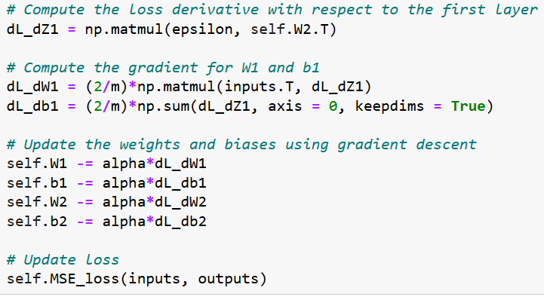
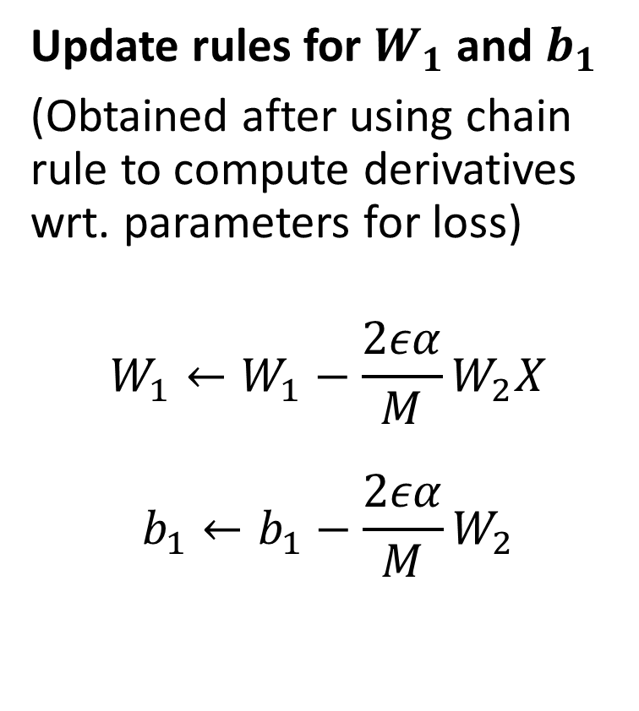
Backpropagation in our model
Update rules for $W_{1}$and $b_{1}$
(Obtained after using chain rule to compute derivatives wrt. parameters for loss)
$$W_{1}←W_{1}−\frac{2εα}{M}W_{2}X$$
$$b_{1}←b_{1}−\frac{2εα}{M}W_{2}$$

Slide 10
Training procedure, in short.
Forward pass on dataset samples. Compute errors and loss function.
Use new loss value to compute gradients. Adjust parameters with backprop.
Repeat until convergence or max number of iterations, as in GD earlier.

Slide 11
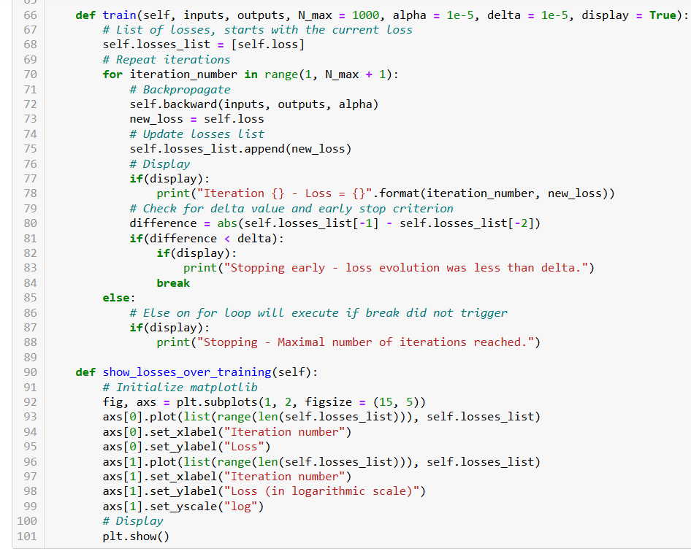
Made that iterative process a trainer method for our class.

Slide 12
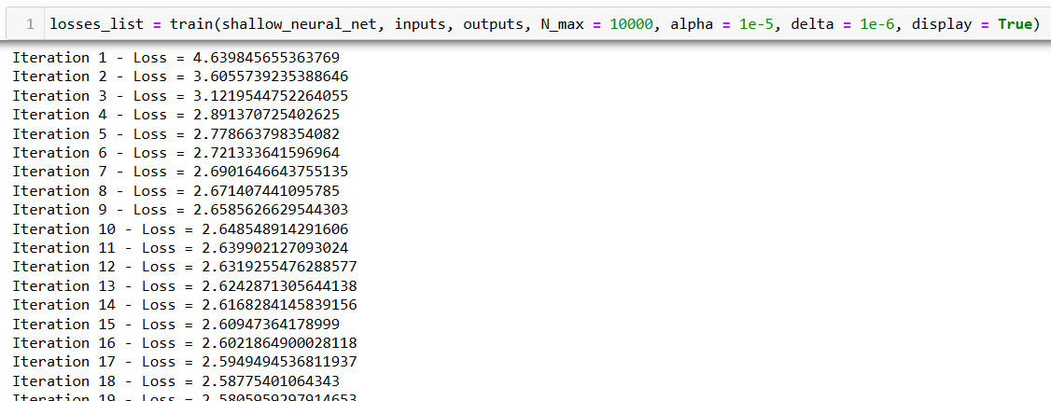
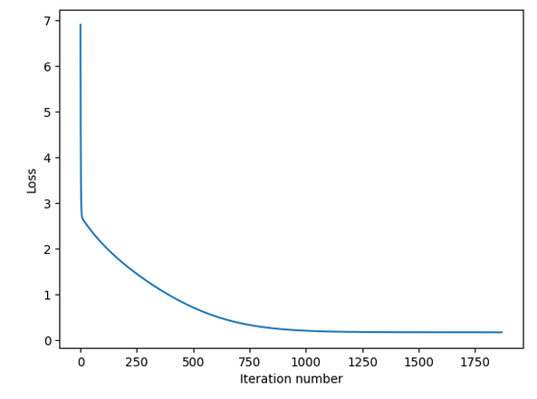
Trainer function for our model

Slide 13
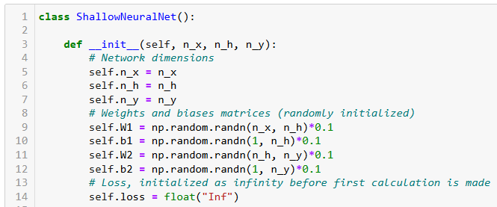
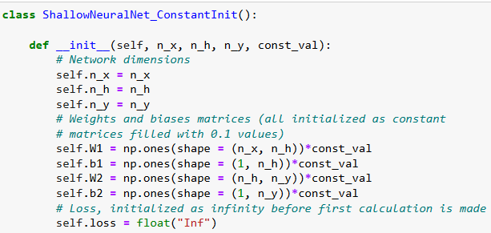
A bad initialization?
In our previous version of the model, we initialized our parameters randomly.
While it seemed unimportant, this is actually essential.
Initializing all parameters as identical constants (e.g. setting all to zeroes) would in fact be a terrible idea.
But we have to try it at least once to understand why.

Slide 14
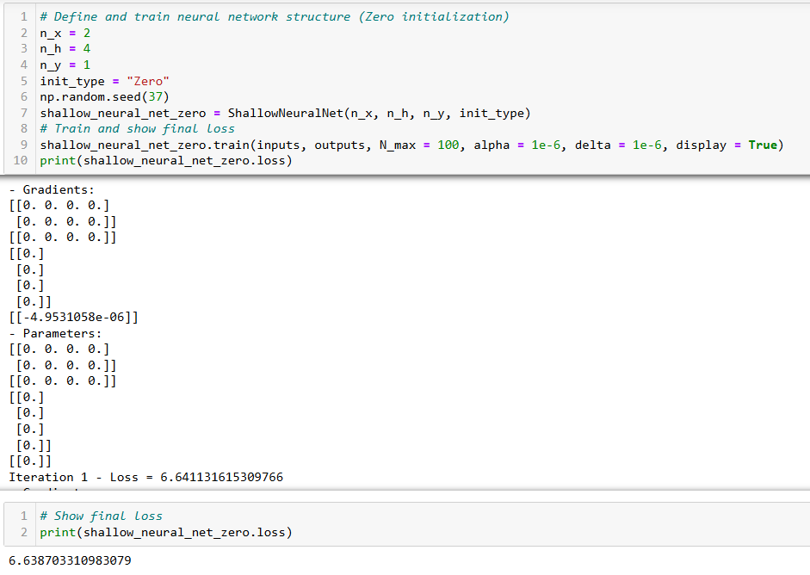
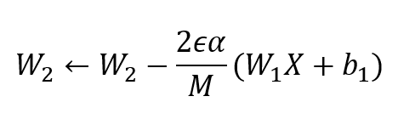
Initializing parameters as zeroes is seriously problematic and the model just does not train.
Why? Look at your Gradient Descent update rules and see what happens if W1, Z2, b1 and b2 are zeroes?

Slide 15
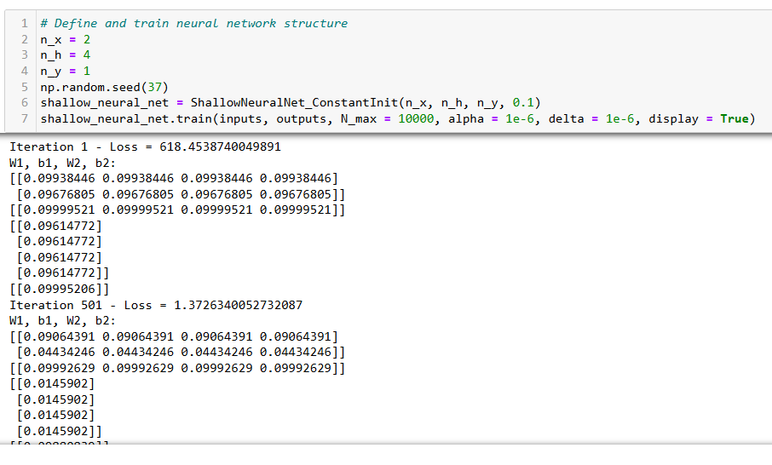
Training the constant initialization model
Same values on all groups of weights
Same thing for bias vector
Keeps happening without discontinuity no matter the number of iterations…
This means all the neurons in a given layer are performing the same calculation! (a.k.a. symmetry in the neural network)

Slide 16
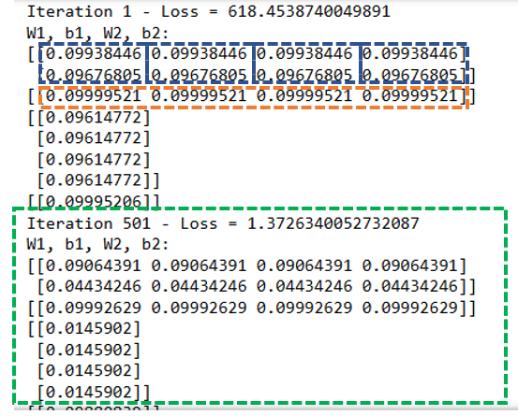
Symmetry in the Neural Network
Definition (Symmetry):
Symmetry in a neural network is the tendency of all neurons to have the same weights and processes (hence doing the same calculations). As a lack of diversity, this can lead to a lack of generalization and can prevent the NN from learning complex patterns.
Additionally, symmetrical neural networks can be vulnerable to adversarial attacks (on Week 5).

Slide 17
Symmetry in the Neural Network
Definition (Symmetry):
Symmetry in a neural network is the tendency of all neurons to have the same weights and processes (hence doing the same calculations). As a lack of diversity, this can lead to a lack of generalization and can prevent the NN from learning complex patterns.
Additionally, symmetrical neural networks can be vulnerable to adversarial attacks (on Week 5).
This happened because all weights and biases elements had the same starting point.
The backward process then updated the parameters identically, and they end up keeping the same values over the course of training.
→ Need to enforce diversity on these parameters from the start! Hence, some random initialization.

Slide 18
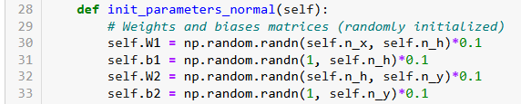
The random normal initialization
Definition (the random normal initialization [LeCun1998]):
The normal random initializer will setup parameters randomly, by sampling from a normal distribution, with a mean 0 and a standard deviation of 1 (or lower). This initializer is pretty straightforward (We used it earlier, in fact!) but can lead to slow convergence or even divergence as the network gets deeper.

Slide 19
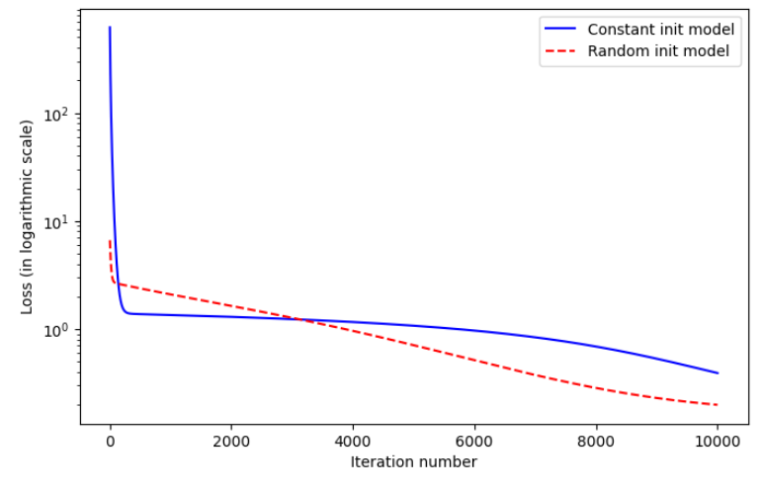
Using a random initialization is just better

Slide 20
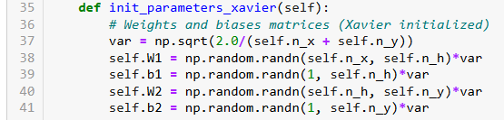
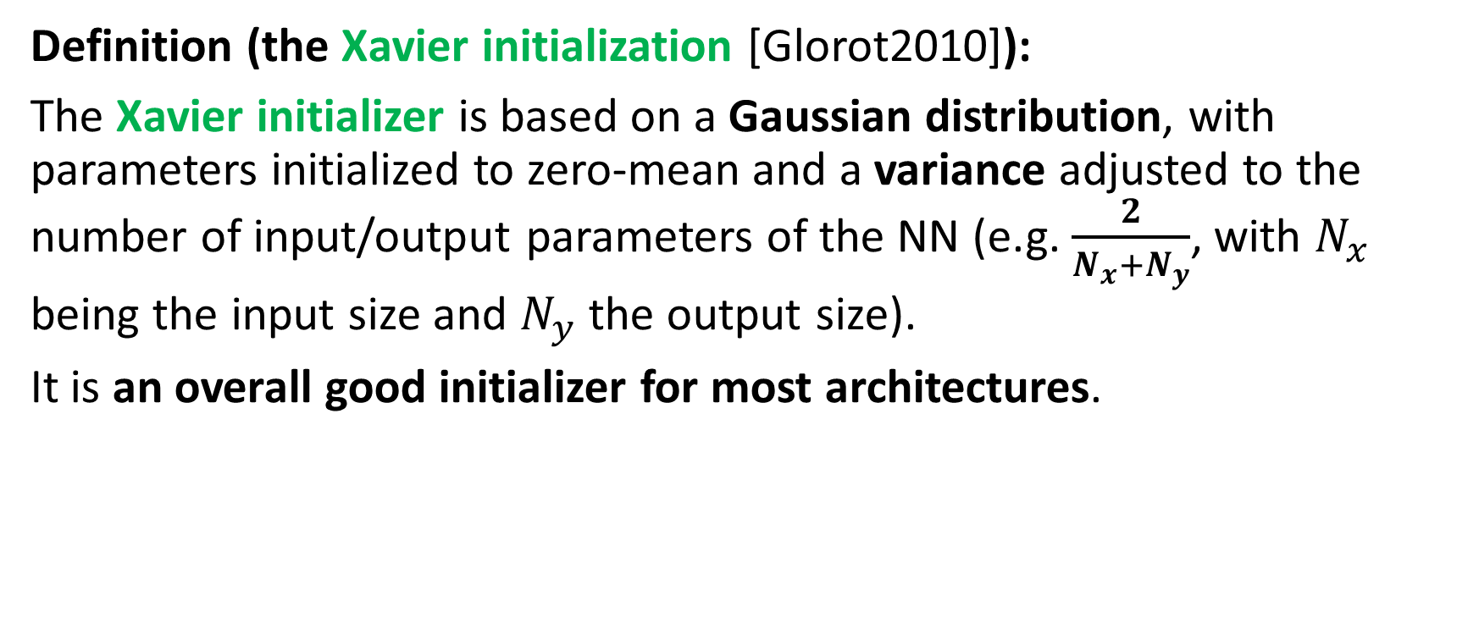
The Xavier initialization
Definition (the Xavier initialization [Glorot2010]):
The Xavier initializer is based on a Gaussian distribution, with parameters initialized to zero-mean and a variance adjusted to the number of input/output parameters of the NN (e.g. $\frac{2}{N_{x}+N_{y}}$, with $N_{x}$ being the input size and $N_{y}$ the output size).
It is an overall good initializer for most architectures.

Slide 21
Initializations variations and more
Many more initialization formulas exist:
Xavier has random uniform and normal variations,
Glorot proposed more initializations, same for He,
Orthogonal initializations are sometimes useful but rare,
Etc.
PyTorch has listed a lot of them, ready to use: https://pytorch.org/docs/stable/nn.init.html
(Have a look at bonus slides if curious!)

Slide 22
No free lunch theorem
Very important note: What I listed earlier about initializers are empirical observations only, certainly not absolute rules.
For this reason, it is a good idea to try a few different initialization techniques and see which one works best for your problem.
Some recent research has also suggested that using a combination of different initialization techniques in different layers (e.g., Xavier initialization for some layers and He initialization for others) can improve overall performance.
In practice, this phenomenon is something that the machine learning community likes to call the “No free lunch theorem“.

Slide 23
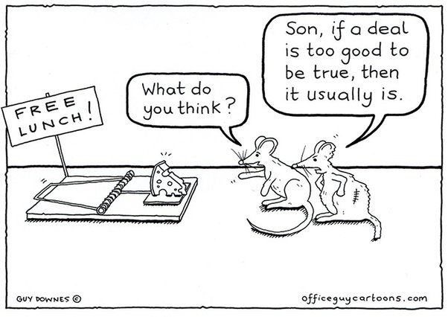
No free lunch theorem
Definition (the No Free Lunch (or NFL) theorem):
The no free lunch (NFL) theorem for supervised machine learning is a theorem that essentially implies that no single machine learning algorithm/tool is universally the best-performing algorithm/tool for all ML problems.
(https://en.wikipedia.org/wiki/No_free_lunch_theorem).
When in doubt about a supposedly “ground-breaking new technique beating all other techniques”, try them out.

Slide 24
No free lunch theorem – season 1
Definition (the No Free Lunch (or NFL) theorem – Season 1):
The no free lunch theorem then implies that there is no such thing “one initializer that works best for all models and problems”.
No choice: try some of them and see how it goes!
(A good read on this matter, also: https://www.deeplearning.ai/ai-notes/initialization/index.html)
When in doubt about a supposedly “ground-breaking new technique beating all other techniques”, try them out.

Slide 25
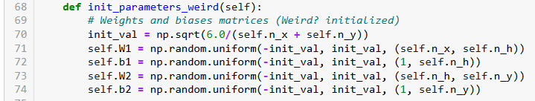
A weird initializer and a new problem
Definition (our custom “weird” initializer):
Let us consider the “weird” initializer below. It uses a random uniform distribution, scaling parameters based on the input and output sizes, like in Xavier. If you check the bonus slides, you could in fact see this initializer as a random uniform variation of Xavier.
And yet, when we use it, something weird happens.

Slide 26
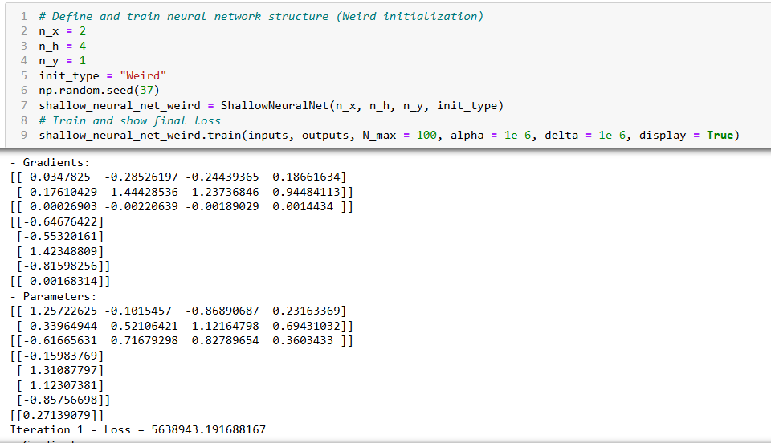
Wow, that is a big loss value!?

Slide 27
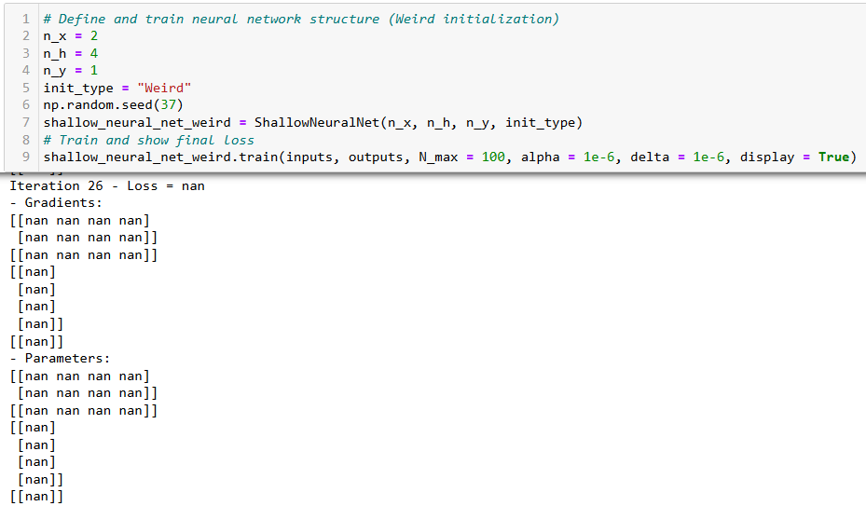
And after iteration 26, we are getting NaNs values (Not a Number values) all over the place…?!
What is going on…?!

Slide 28
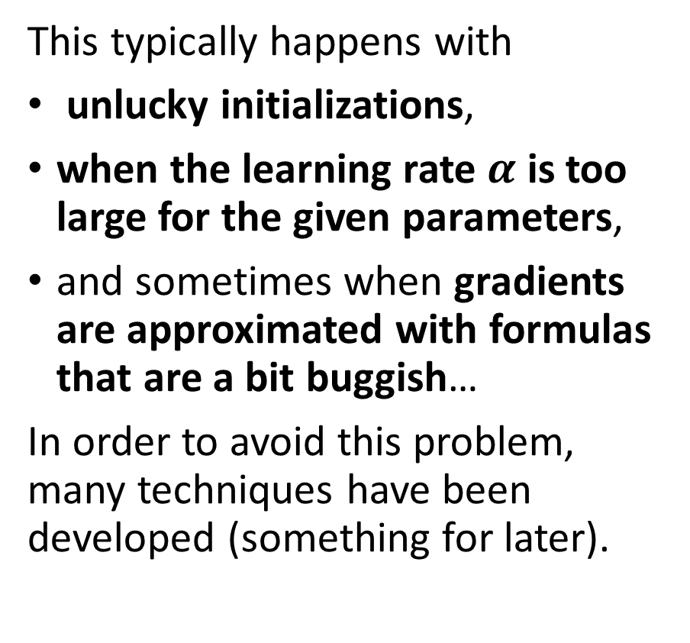
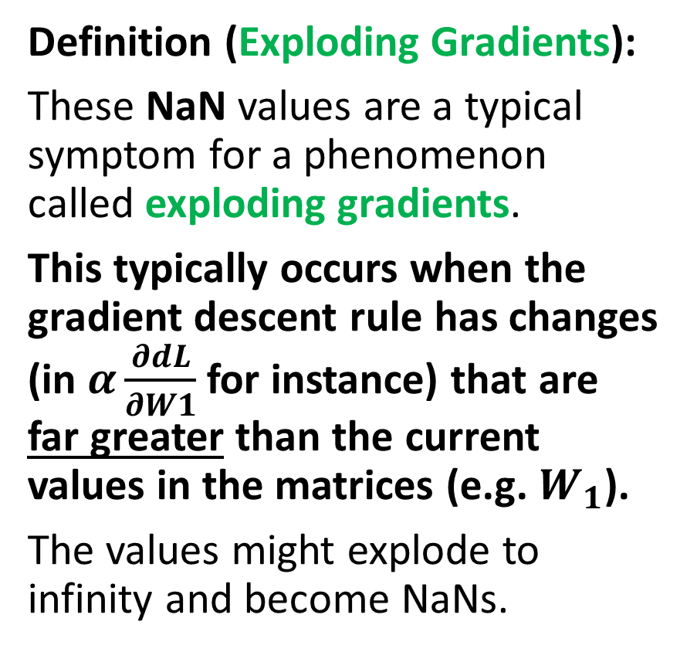
The exploding gradient problem
Definition (Exploding Gradients):
These NaN values are a typical symptom for a phenomenon called exploding gradients.
This typically occurs when the gradient descent rule has changes (in $α\frac{∂dL}{∂W1}$for instance) that are far greater than the current values in the matrices (e.g. $W_{1}$).
The values might explode to infinity and become NaNs.
This typically happens with
unlucky initializations,
when the learning rate $α$ is too large for the given parameters,
and sometimes when gradients are approximated with formulas that are a bit buggish…
In order to avoid this problem, many techniques have been developed (something for later).

Slide 29
Unlucky initialization
Definition (Unlucky Initialization):
Unlucky Initialization is a typical example used to describe that a ML system's behaviour is hard to predict due to the random impact of its initial conditions.
In some cases, the result of a training will be drastically different depending on the initial values used, which can lead to vastly different outcomes for your model.
In fact, in our previous “weird” initializer, we can resolve the exploding gradient/NaN problem… By just using a different seed for the initialization…!
Yup, we just had an unlucky initialization, as simple as that!
(BTW, that could be an empirical proof that the NFL theorem is indeed true!)

Slide 30
Seed 37 is an unlucky initialization…

Slide 31
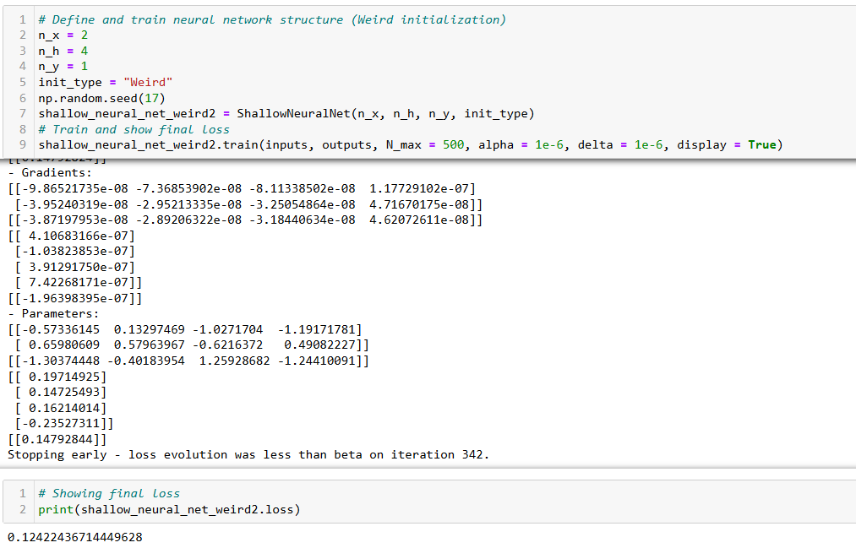
Different seed…
Now that works?!

Slide 32
The learning rate tradeoff
Definition (Learning rate trade-off):
The learning rate is a hyperparameter which controls the step size taken by the algorithm in order to minimize the loss function during training.
If the learning rate is too small, the algorithm will take longer to converge, but it can also prevent overshooting the global minimum. It might, however, lead to being stuck in non-optimum local minima.
If the learning rate is too high, the algorithm may converge faster, but it may lead to exploding gradients.

Slide 33
The learning rate tradeoff
Definition (Learning rate trade-off):
There is therefore a trade-off on the deep learning rate, and as in all things with trade-offs, it is about finding the optimal middle ground.
High Learning rate value:
Trains faster
Risk of overshooting min
Risk of exploding gradient
Low learning value:
Trains slow, but safe
Risk of training so slow we barely make any changes

Slide 34
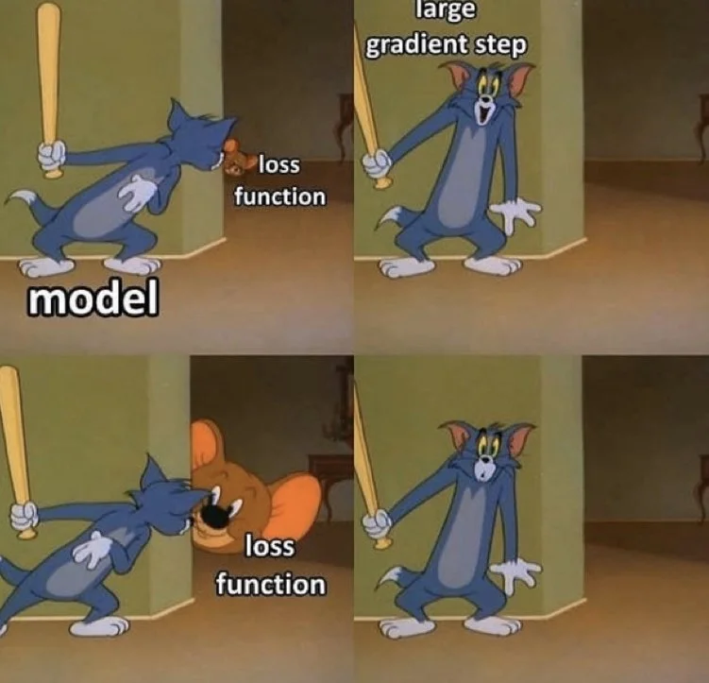
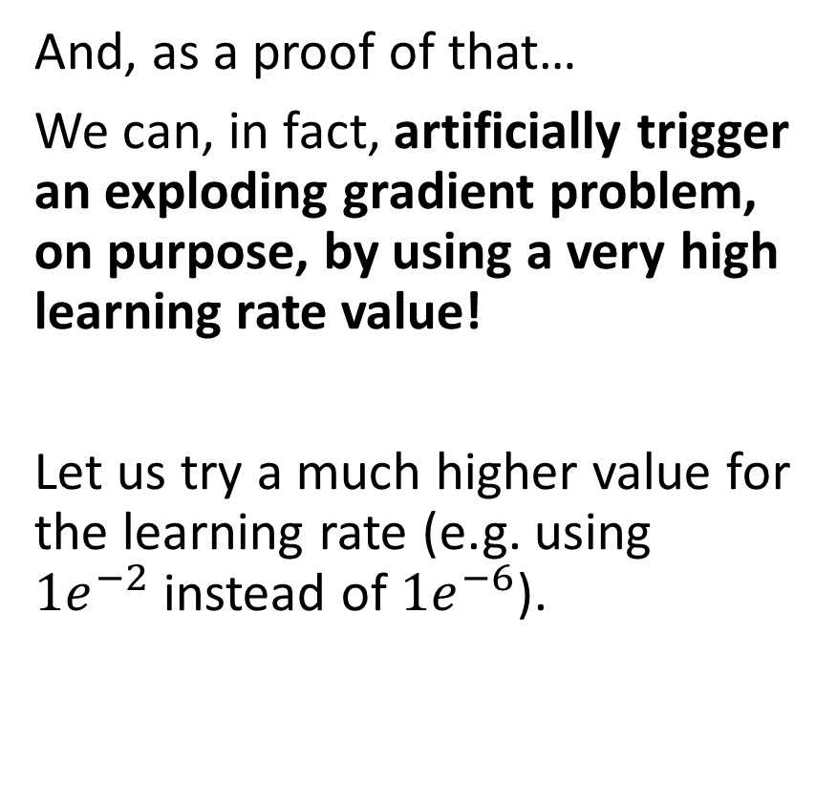
Triggering an exploding gradient on purpose
And, as a proof of that…
We can, in fact, artificially trigger an exploding gradient problem, on purpose, by using a very high learning rate value!
Let us try a much higher value for the learning rate (e.g. using $1e^{−2}$instead of $1e^{−6}$).

Slide 35
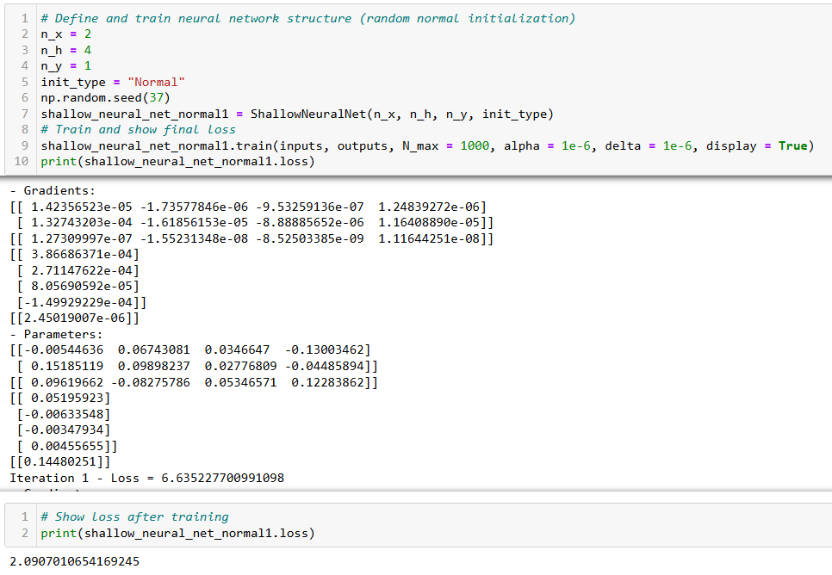
Normal initialization and low learning rate (1e-6)
This is fine…

Slide 36
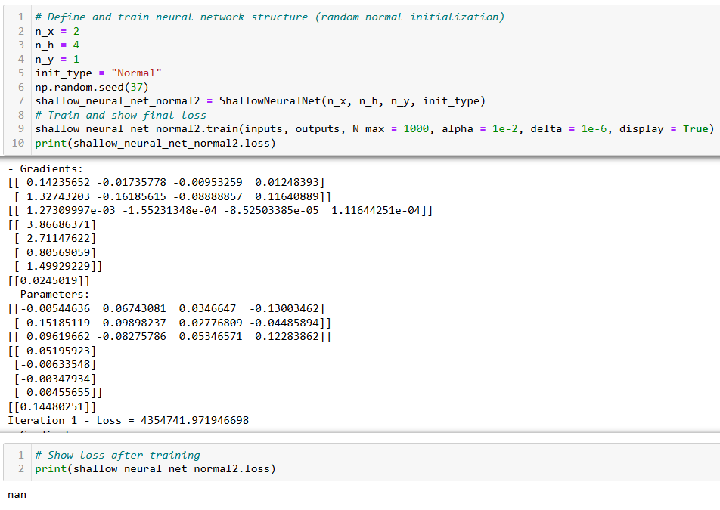
Learning rate too high leads to exploding gradients!

Slide 37

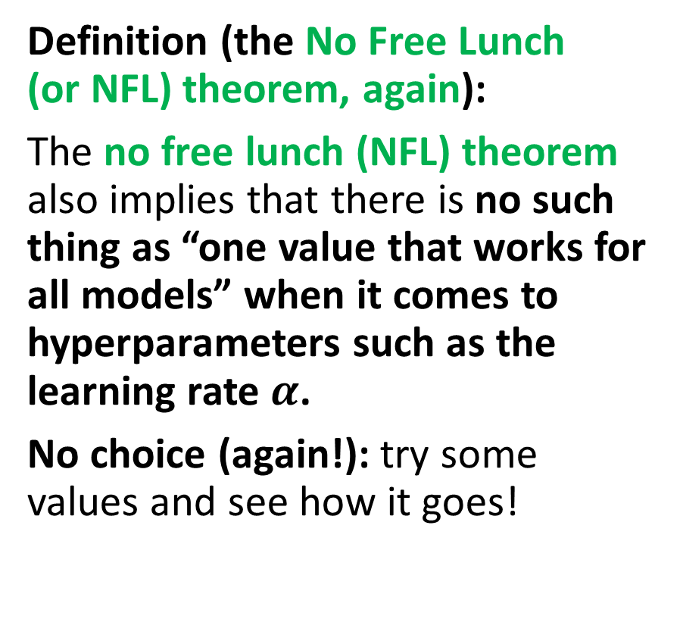
No free lunch theorem, again
Definition (the No Free Lunch (or NFL) theorem, again):
The no free lunch (NFL) theorem also implies that there is no such thing as “one value that works for all models” when it comes to hyperparameters such as the learning rate $α$.
No choice (again!): try some values and see how it goes!

Slide 38
About hyperparameters tuning
Definition (Hyperparameters and Hyperparameter tuning):
As we have seen, the learning rate is a hyperparameter that needs to be carefully chosen.
In fact, an important part of deep learning is hyperparameter tuning.
It consists, for instance, of finding a good learning rate value that will allow the algorithm to converge quickly and reliably.
For a given model, there could be multiple hyperparameters:
for instance, the lambda value in regularization is also an important hyperparameter,
the number of neurons used in a given layer,
the number of layers used in the neural network,
the initialization method for parameters,
Etc.

Slide 39
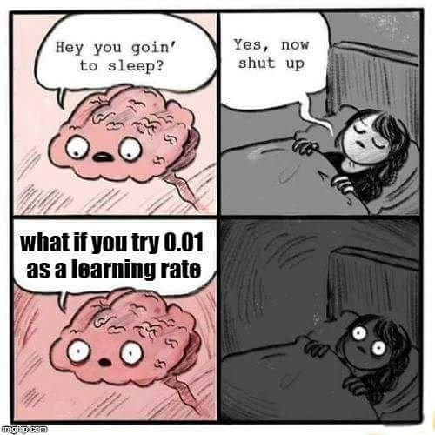
About hyperparameters tuning
Sadly, that is sometimes all it takes to make the difference between a model that successfully trains and a model that does not!

Slide 40
Controlling gradients to prevent explosions
Adjusting and trying different values for the learning rate is often good enough to prevent exploding gradients.
There are also other options, like:
Downscaling initial parameters values: Divide initial parameter values by a certain factor to prevent large initial values on parameters.
Gradient clipping: Set a max value for change on a single iteration and truncate any change that goes above that (to be discussed later).
Time evolution on learning rate: Make the learning rate value change over time, make it large at the beginning and progressively decrease it over iterations (to be discussed later).

Slide 41
Back to our first exploding gradient example…

Slide 42
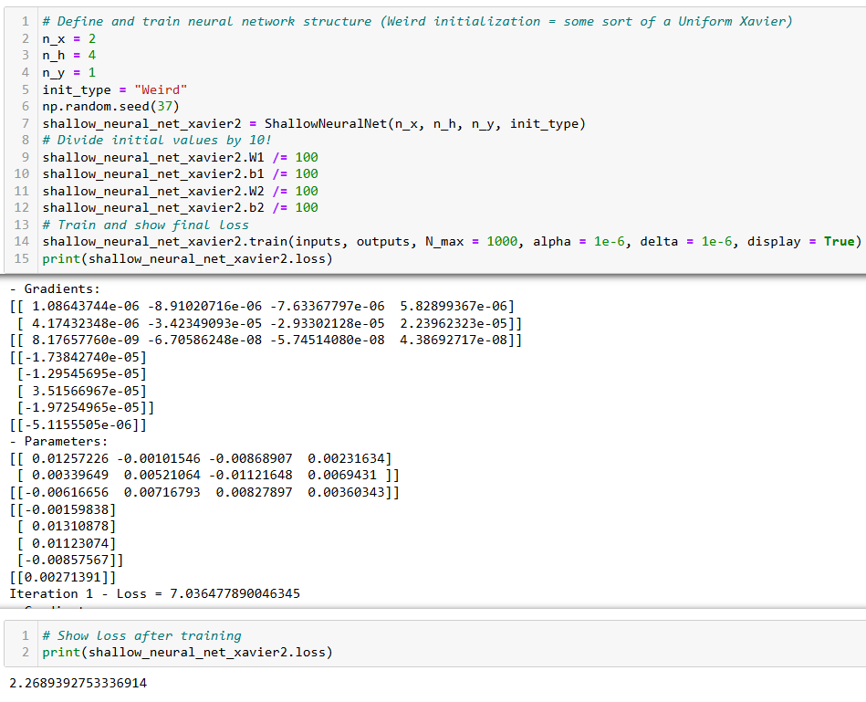
Downscaling parameters during initialization fixed the exploding gradients issue, but it leads to slower training.

Slide 43
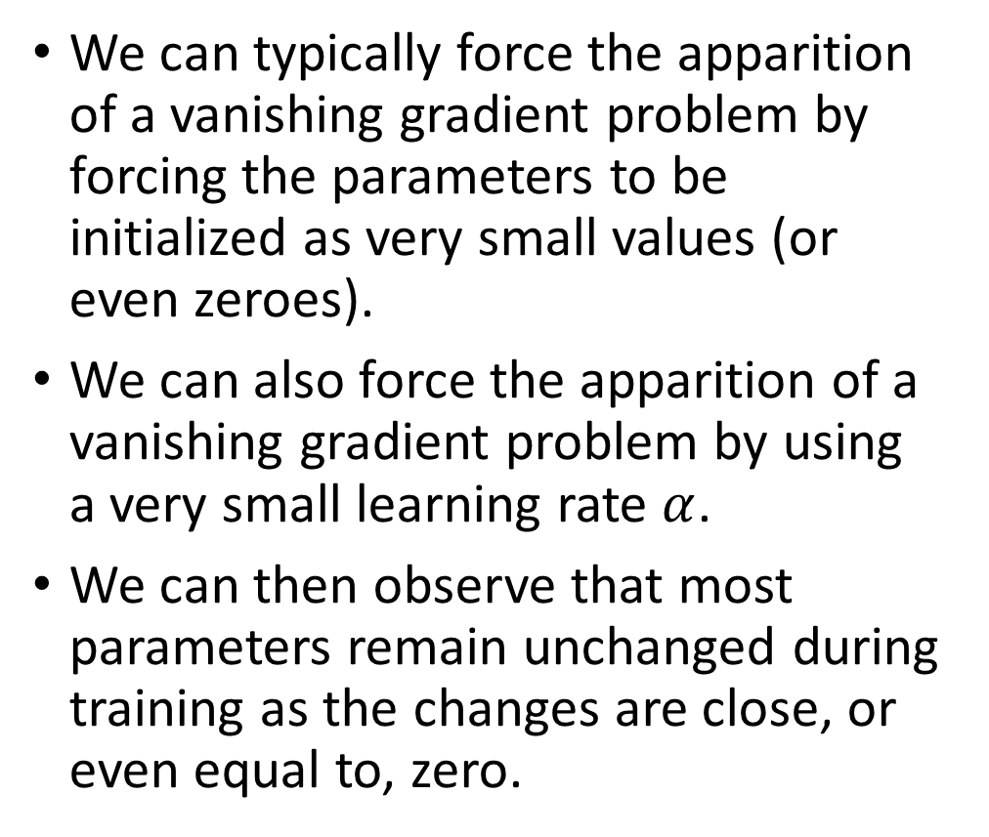
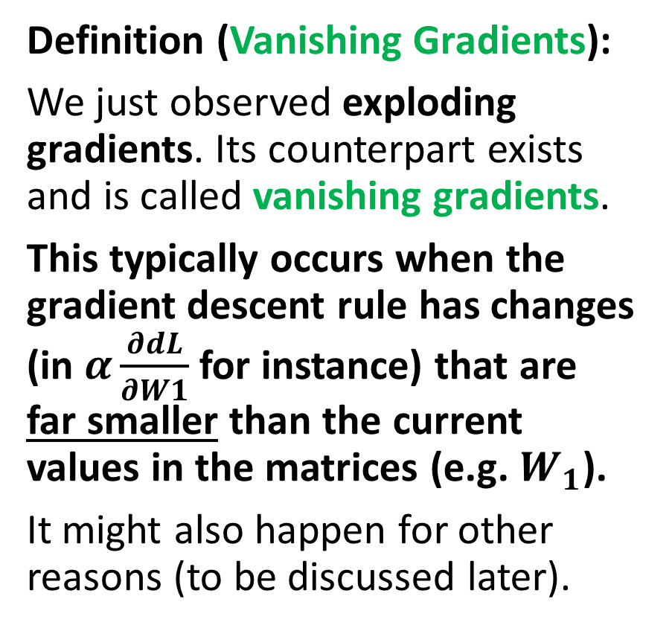
The vanishing gradient problem
Definition (Vanishing Gradients):
We just observed exploding gradients. Its counterpart exists and is called vanishing gradients.
This typically occurs when the gradient descent rule has changes (in $α\frac{∂dL}{∂W1}$for instance) that are far smaller than the current values in the matrices (e.g. $W_{1}$).
It might also happen for other reasons (to be discussed later).
We can typically force the apparition of a vanishing gradient problem by forcing the parameters to be initialized as very small values (or even zeroes).
We can also force the apparition of a vanishing gradient problem by using a very small learning rate $α$.
We can then observe that most parameters remain unchanged during training as the changes are close, or even equal to, zero.

Slide 44
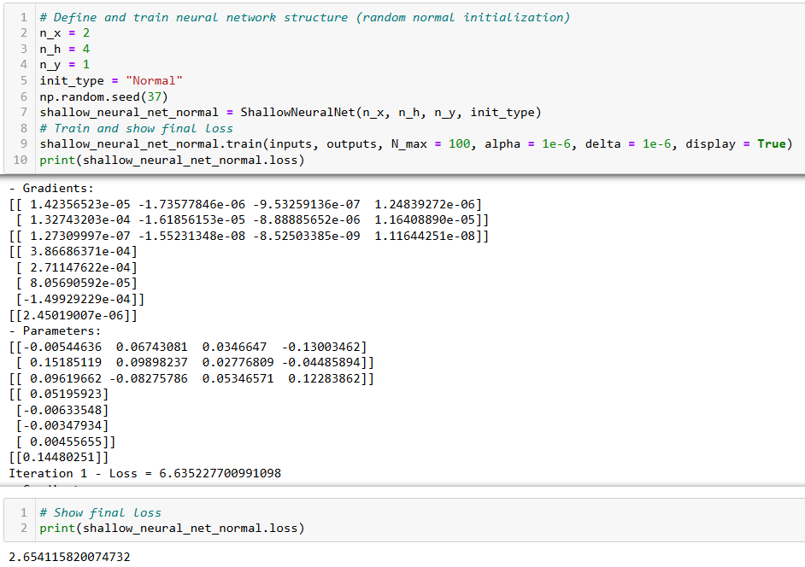
This is fine.

Slide 45
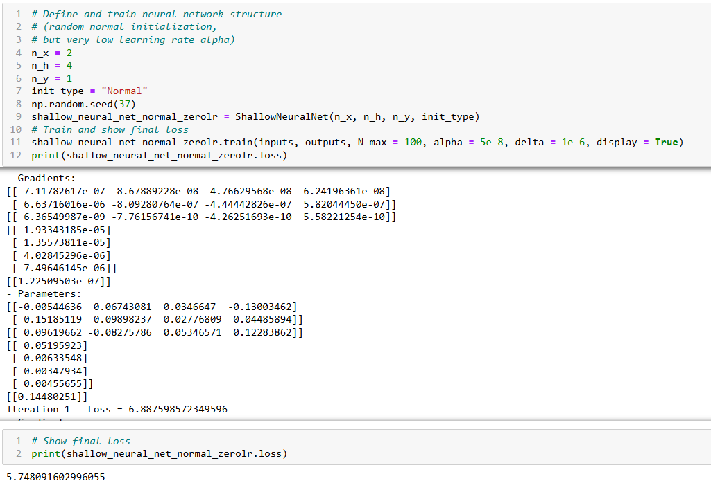
Setting up a learning rate that is too small might also seriously hinder the training (a.k.a. vanishing gradients). And sometimes even lead to a “convergence” to wrong minimum.

Slide 46
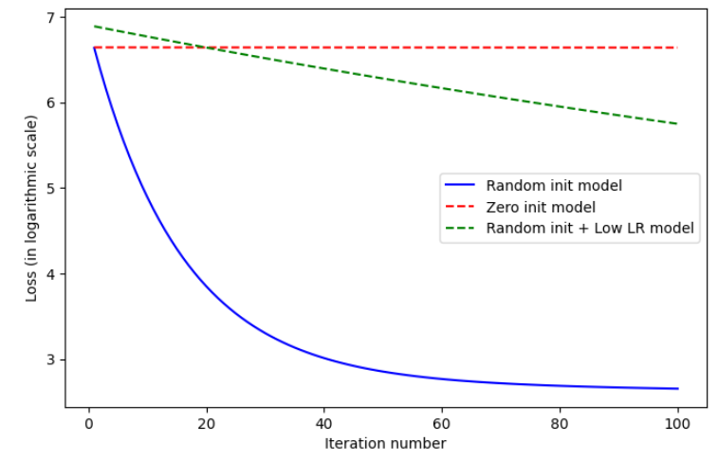

Slide 47
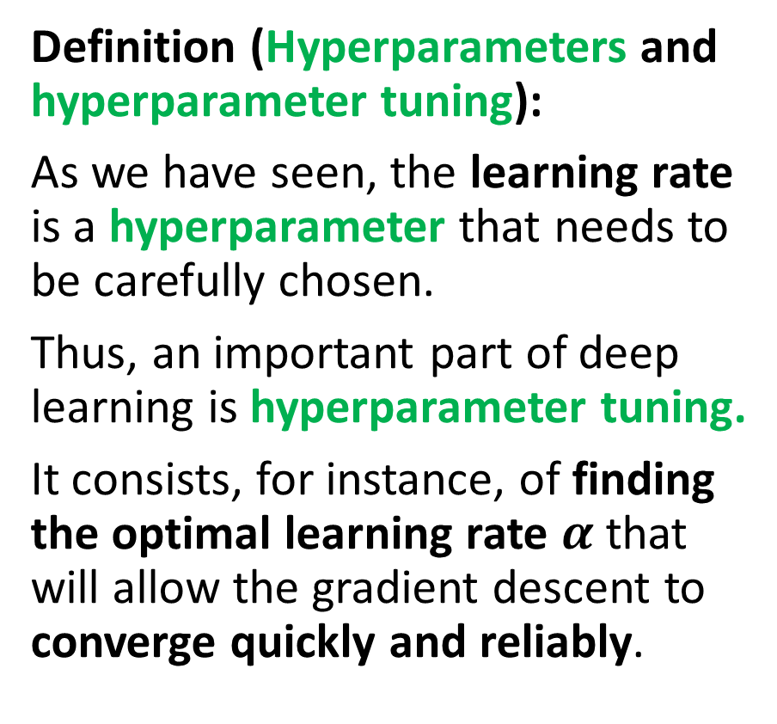
Remember, the learning rate tradeoff
Definition (Hyperparameters and hyperparameter tuning):
As we have seen, the learning rate is a hyperparameter that needs to be carefully chosen.
Thus, an important part of deep learning is hyperparameter tuning.
It consists, for instance, of finding the optimal learning rate $α$ that will allow the gradient descent to converge quickly and reliably.

Slide 48
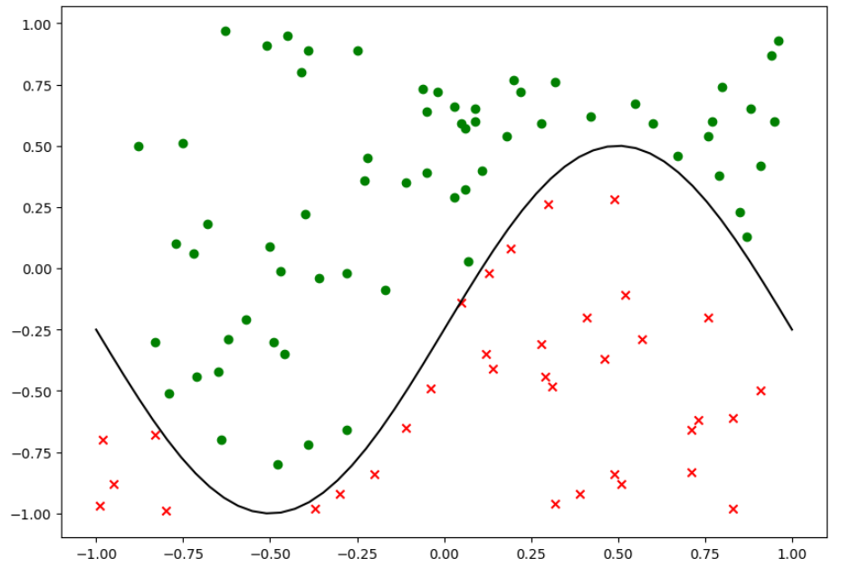
New dataset! (An abstract one this time)

Slide 49
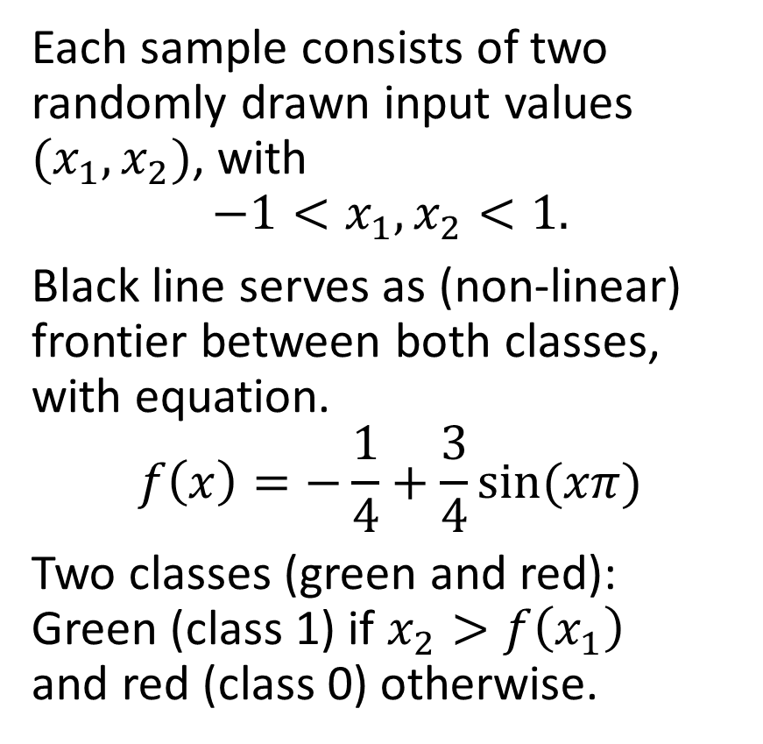
New dataset! (An abstract one this time)
Each sample consists of two randomly drawn input values $(x_{1}, x_{2})$, with
$$−1<x_{1}, x_{2}<1.$$
Black line serves as (non-linear) frontier between both classes, with equation.
$$f\left(x\right)=−\frac{1}{4}+\frac{3}{4}sin⁡(xπ)$$
Two classes (green and red): Green (class 1) if $x_{2}>f\left(x_{1}\right)$ and red (class 0) otherwise.

Slide 50
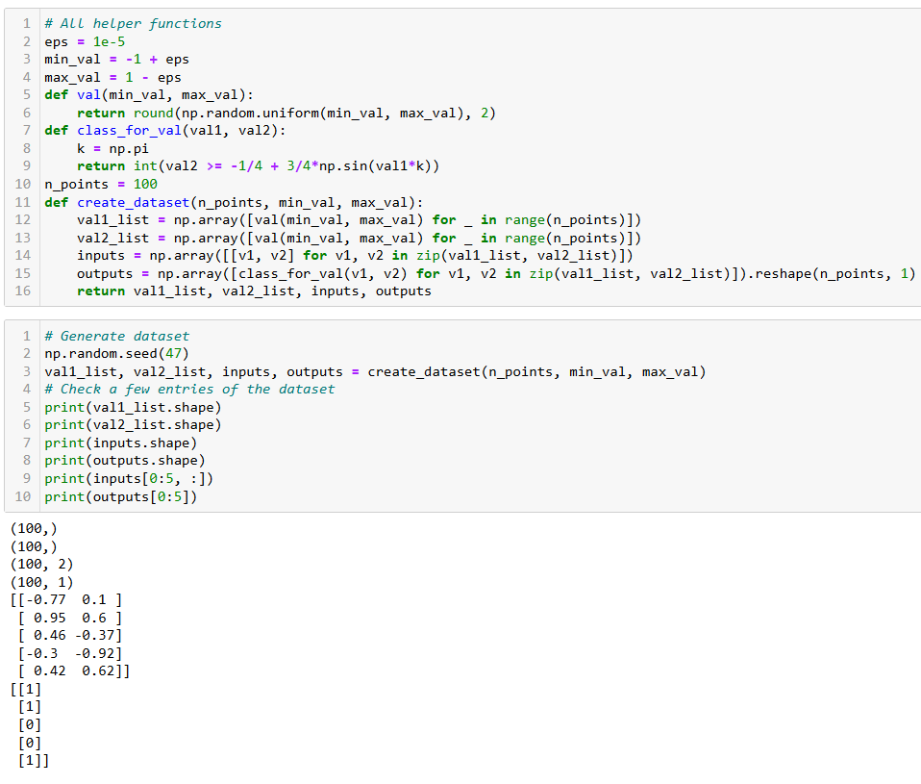
New dataset!
We can generate some entries using the helper functions here.
Basically, drawing pairs of values randomly and checking if above or below the sine line.

Slide 51
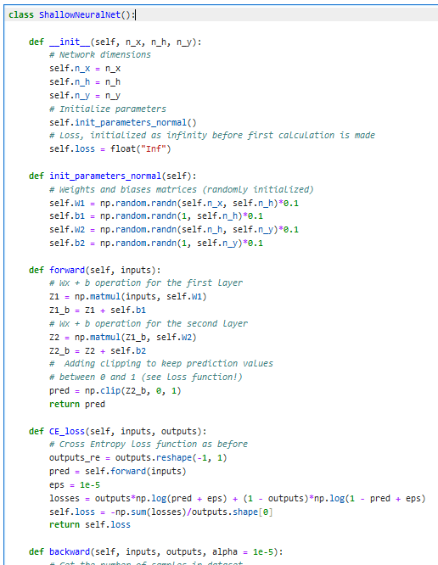
Adjusting our shallow NN
We can adjust our shallow neural network to the task by:
Using the same two layers as before.
Simply adding a clipping to the final value of the forward method to ensure values between 0 and 1.
Replace MSE with our cross-entropy loss function (as in Log. Reg.).
Backward and trainer methods are left untouched.

Slide 52
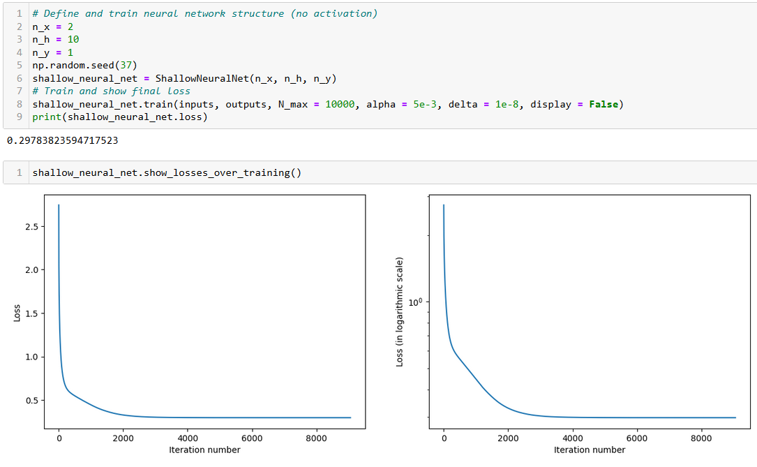
It trains just fine! (or does it?)
Training curves looking nice, but does that mean the model is good?

Slide 53
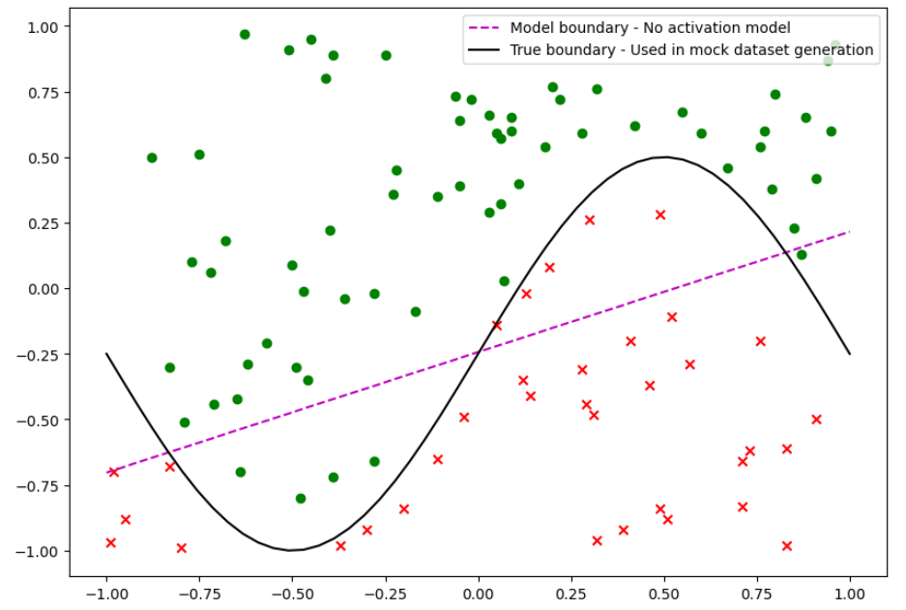
It trains just fine! (or does it?)
Errrm… NOPE!

Slide 54
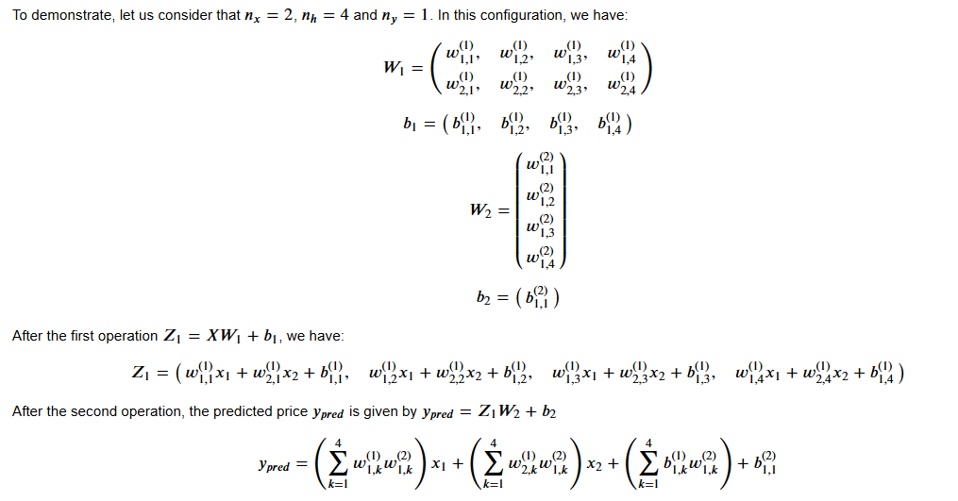
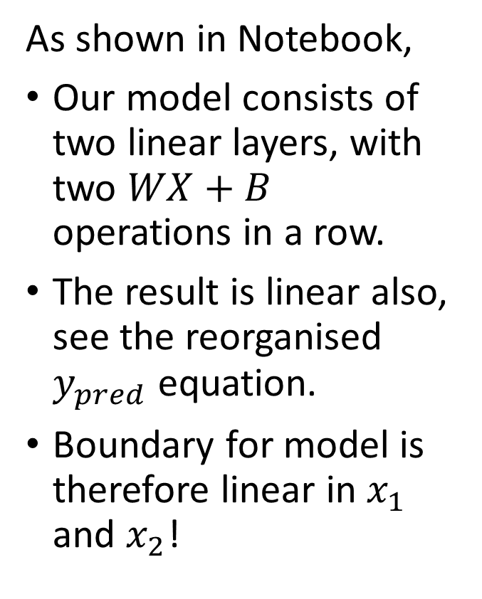
Linear layers necessarily lead to linear boundary
As shown in Notebook,
Our model consists of two linear layers, with two $WX+B$ operations in a row.
The result is linear also, see the reorganised $y_{pred}$ equation.
Boundary for model is therefore linear in $x_{1}$ and $x_{2}$!

Slide 55
Trains just fine! (or does it?)
Well, that is going to be a problem, because the black boundary is definitely not linear…
Or, in other words, the data is not linearly separable.

Slide 56
Activation functions and introducing non-linearity in the Neural Networks
Definition (Activation functions and non-linearity):
Activation functions are an important component of neural networks because they introduce non-linearity to the model.
Simply done by adding an activation operation after each linear one, for instance our sigmoid function.
(Important because most real-world data is non-linear.)
Layer input X
Linear operation Z = WX+B
Activation function A = s(Z)
Layer output A
Our new layer prototype, to be used in place of the Linear operation only

Slide 57

Adding sigmoid activations
We can update our model by:
Adding a sigmoid method, implementing the sigmoid operation from earlier.
Adding sigmoid operations after each linear operation in the forward method.
Our cross-entropy loss method remains unchanged, as it will simply use the updated forward procedure.

Slide 58
Adding sigmoid activations
Careful now…
As the forward procedure has changed, we would have to update the backward propagation…

Slide 59

Adding sigmoid activations
When you realize you have to re-do the entire backpropagation calculation and implementation to account for a small change of an activation function
Careful now…
As the forward procedure has changed, we would have to update the backward propagation…
This means we have to go back to using the chain rule manual differentiation procedure, account for the new sigmoid operations, and get the new update rules to use in the backward method…

Slide 60
Step 1: Drawing a computation graph
Inputs $X$
Inputs 𝑋
Linear #1 $$Z_{1}= W_{1}X + b_{1}$$
Linear #1 Z_1= 𝑊_1 𝑋 + 𝑏_1
Sigmoid
$$A_{1} = s(Z_{1})$$
Sigmoid
𝐴_1 = 𝑠(𝑍_1)
Linear #2 $$Z_{2}= W_{2}A_{1} + b_{2}$$
Linear #2 Z_2= 𝑊_2 𝐴_1 + 𝑏_2
Second Sigmoid and Final Prediction
$$A_{2} = s(Z_{2})$$
Second Sigmoid and Final Prediction
𝐴_2 = 𝑠(𝑍_2)
Cross Entropy Loss $L(A_{2}, Y)$
Cross Entropy Loss 𝐿(𝐴_2, 𝑌)

Slide 61

Step 1: Drawing a computation graph
Inputs $X$
Inputs 𝑋
Linear #1 $$Z_{1}= W_{1}X + b_{1}$$
Linear #1 Z_1= 𝑊_1 𝑋 + 𝑏_1
Sigmoid
$$A_{1} = s(Z_{1})$$
Sigmoid
𝐴_1 = 𝑠(𝑍_1)
Linear #2 $$Z_{2}= W_{2}A_{1} + b_{2}$$
Linear #2 Z_2= 𝑊_2 𝐴_1 + 𝑏_2
Second Sigmoid and Final Prediction
$$A_{2} = s(Z_{2})$$
Second Sigmoid and Final Prediction
𝐴_2 = 𝑠(𝑍_2)
Cross Entropy Loss $L(A_{2}, Y)$
Cross Entropy Loss 𝐿(𝐴_2, 𝑌)
Intuition: If you remember W1S3, we showed that…
$$LinReg + Sigmoid≈ LogReg$$
Here, we are applying Sigmoid on a Linear Operation Layer, so…
$$LinReg Layer + Sigmoid≈ LogReg Layer?$$
LogReg Layer of some sort?

Slide 62

Step 2: Recall the forward equations
Our forward method gives:
$$Z_{1} = W_{1}X + b_{1}$$
$$A_{1} = s(Z_{1})$$
$$Z_{2} = W_{2}A_{1} + b_{2}$$
$$A_{2} = s(Z_{2})$$
$$L =\frac{−1}{N} \sum_{i}^{N}{Y\ln\left(A_{2}\right)+\left(1−Y\right)ln(}1−A_{2})$$

Slide 63

Step 3: Use the chain rule to backpropagate
Retrieving the gradient descent update rules takes a few steps and requires some organizing…
First, recall that our loss function is defined as
$$L =\frac{−1}{N} \sum_{i}^{N}{Y\ln\left(A_{2}\right)+\left(1−Y\right)ln(}1−A_{2})$$
Therefore, we have
$$\frac{∂L}{∂A_{2}}=\frac{1}{N}\left(−\frac{Y}{A_{2}}+\frac{1−Y}{1−A_{2}}\right)$$

Slide 64

Step 3: Use the chain rule to backpropagate
Then, recall that
$$A_{2} = s(Z_{2})$$
We can then prove that
$$\frac{∂s\left(X\right)}{∂X}=s\left(X\right)\left(1−s\left(X\right)\right)$$
Using the chain rule, we then obtain
$$\frac{∂L}{∂Z_{2}}=\frac{∂L}{∂A_{2}}\frac{∂A_{2}}{∂Z_{2}}=\frac{∂L}{∂A_{2}}A_{2}(1−A_{2})$$

Slide 65

Step 3: Use the chain rule to backpropagate
Let us continue $Z_{2} = W_{2}A_{1} + b_{2}$
Using the chain rule, we then obtain
$$\frac{∂L}{∂W_{2}}=\frac{∂L}{∂Z_{2}}\frac{∂Z_{2}}{∂W_{2}}=\frac{∂L}{∂Z_{2}}A_{1}$$
$$\frac{∂L}{∂b_{2}}=\frac{∂L}{∂Z_{2}}\frac{∂Z_{2}}{∂b_{2}}=\frac{∂L}{∂Z_{2}}$$

Slide 66

Step 3: Use the chain rule to backpropagate
Again…
$$Z_{2} = W_{2}A_{1} + b_{2}$$
$$A_{1} = s(Z_{1})$$
Using the chain rule and our sigmoid derivative, we then obtain
$$\frac{∂L}{∂A_{1}}=\frac{∂L}{∂Z_{2}}\frac{∂Z_{2}}{∂A_{1}}=\frac{∂L}{∂Z_{2}}W_{2}$$

Slide 67

Step 3: Use the chain rule to backpropagate
Almost there…
$$Z_{2} = W_{2}A_{1} + b_{2}$$
$$A_{1} = s(Z_{1})$$
Using the chain rule and our sigmoid derivative, we then obtain
$$\frac{∂L}{∂A_{1}}=\frac{∂L}{∂Z_{2}}\frac{∂Z_{2}}{∂A_{1}}=\frac{∂L}{∂Z_{2}}W_{2}$$
$$\frac{∂L}{∂Z_{1}}=\frac{∂L}{∂A_{1}}\frac{∂A_{1}}{∂Z_{1}}=\frac{∂L}{∂A_{1}}A_{1}(1−A_{1})$$

Slide 68

Step 3: Use the chain rule to backpropagate
Finally…!
$$Z_{1} = W_{1}X+ b_{1}$$
Using the chain rule and our sigmoid derivative, we then obtain
$$\frac{∂L}{∂W_{1}}=\frac{∂L}{∂Z_{1}}\frac{∂Z_{1}}{∂W_{1}}=\frac{∂L}{∂Z_{1}}X$$
$$\frac{∂L}{∂b_{1}}=\frac{∂L}{∂Z_{1}}\frac{∂Z_{1}}{∂b_{1}}=\frac{∂L}{∂Z_{1}}$$

Slide 69

Backward Method Update
Reusing our derivatives formulas carefully gives the GD update rules to use for the backward method.
Notice how we did not rush and computed each term, one operation at a time, to avoid making mistakes.
Take it slow and careful about matrix sizes!

Slide 70

Trains just fine! (Much lower loss BTW!)

Slide 71

Trains just fine!
Using the sigmoid activation functions helped the network create some non-linearity!
(Blue curve looking good and correctly separating green from red!)

Slide 72



Examples of activations: Sigmoid
Definition (Sigmoid function):
$$s\left(x\right)=\frac{1}{1+exp⁡(−x)}$$
The sigmoid activation function is often used in the output layer of a binary classification model, because the output will then have values between 0 and 1, and can therefore be interpreted as a probability.

Slide 73


Examples of activations: Hyperbolic tangent
Definition (Tanh function):
The tanh (short for "hyperbolic tangent") activation function is somewhat similar to the sigmoid function, but it maps values to a range between -1 and 1.
Like the sigmoid function, it is often used in the output layer of a classification model.

Slide 74
About Sigmoid and Tanh functions
Some observations about Sigmoid and Tanh functions (empirical, subject to No Free Lunch!)
Those activation functions were widely used prior to ReLU.
People were very comfortable with those as they were reminiscent of Logistic Regression and they are simply differentiable.
The problem with those is that being squeezed between [0, 1] or [-1, 1], we can have a hard time training deep networks, as the gradient will tend to vanish when neurons want to output values close to the interval bounds (0, 1, and -1) as layer outputs.
Indeed, derivatives of these activations are closer to 0 when sigmoid/tanh produce values close their interval bounds!

Slide 75


Examples of activations: ReLU
Definition (ReLU function):
The ReLU (short for "Rectified Linear Unit") activation function is a function that maps any input value less than 0 to 0, and any input value greater than or equal to 0 to the input value itself.
It is widely used because it is computationally efficient and does not saturate (i.e., "die") like some previous activation functions.
From [Glorot2011].

Slide 76


Examples of activations: Leaky ReLU
Definition (Leaky ReLU function):
The leaky ReLU activation function is similar to the ReLU function, but it allows a small negative slope for input values less than 0.
This can help to alleviate the "dying ReLU" problem, where some neurons in the network "die" when they produce negative values and might no longer respond to input.

Slide 77

A note on activation functions
We have listed the most common activation functions, which are used most of the time.
Keep in mind that many more activation functions exist, some of them being very advanced or niche, but worth keeping an eye on. https://pytorch.org/docs/stable/nn.html#non-linear-activations-weighted-sum-nonlinearity
(More in bonus slides!)

Slide 78

A note on activation functions
We have listed the most common activation functions, which are used 99% of the time.
Keep in mind that many more activation functions exist, some of them being very niche, but worth keeping an eye on. Have a look at the list here: https://pytorch.org/docs/stable/nn.html#non-linear-activations-weighted-sum-nonlinearity

Slide 79

The universal approximation theorem
Definition (the Universal Approximation Theorem):
Mathematically speaking, any neural network architecture aims at finding the mathematical function $y= f(x)$that can map some given inputs $x$ to outputs $y$. This function $f(x)$ can be arbitrarily complex, based on the dataset and task at hand.
The Universal Approximation Theorem states that Neural Networks have a kind of universality property.
In Layman terms, no matter what $f(x)$might be, there is a neural network that can approach the function $f\left(x\right)$ with a given precision!
As such, this is the most important theorem of Deep Learning!

Slide 80

The universal approximation theorem
Two caveats, however:
- The model in question might be unfeasibly large (“slightly” annoying…!)
- And the resulting model is not even guaranteed to generalize (still our main goal last time I checked)
Definition (the Universal Approximation Theorem):
Mathematically speaking, any neural network architecture aims at finding the mathematical function $y= f(x)$that can map some given inputs $x$ to outputs $y$. This function $f(x)$ can be arbitrarily complex, based on the dataset and task at hand.
The Universal Approximation Theorem states that Neural Networks have a kind of universality property.
In Layman terms, no matter what $f(x)$might be, there is a neural network that can approach the function $f\left(x\right)$ with a given precision!
As such, this is the most important theorem of Deep Learning!

Slide 81
Learn more about these topics
Out of class, supporting papers, for those of you who are curious.
[LeCun1998] Y. LeCun, Y. Bengio, and G. Hinton, “Efficient backprop. In Neural networks: Tricks of the trade”, 1998.
[Glorot2010] X. Glorot, and Y. Bengio, “Understanding the difficulty of training deep feedforward neural networks”, 2010.
[He2015] K. He, X. Zhang, S. Ren, & J. Sun, “Delving deep into rectifiers: Surpassing human-level performance on imagenet classification.”, 2015.

Slide 82
Learn more about these topics
Out of class, supporting papers, for those of you who are curious.
[LeCun1998bis] Y. LeCun, L. Bottou, Y. Bengio, and P. Haffner “Gradient-based learning applied to document recognition.”, 1998.
[Glorot2011] X. Glorot, A. Bordes, and Y. Bengio, “Deep Sparse Rectifier Neural Networks”, 2011.
[Dubey2022] S. R. Dubey et al., “Activation Functions in Deep Learning: A Comprehensive Survey and Benchmark”, 2022.

Slide 83
Learn more about these topics
Tracking important names (Track their works and follow them on Scholar, Twitter, or whatever works for you!)
Yann LeCun: Formerly, chief AI Scientist at Facebook/Meta and Silver Professor at the New York University, another one of the three Godfathers of Deep Learning and 2018 Turing Award winner (highest distinction in Computer Science). http://yann.lecun.com/ https://scholar.google.com/citations?user=WLN3QrAAAAAJ&hl=fr
Yoshua Bengio: Professor at University of Montreal, last of the three Godfathers of Deep Learning and 2018 Turing Award winner (highest distinction in Computer Science). https://yoshuabengio.org https://scholar.google.com/citations?user=kukA0LcAAAAJ&hl=fr

Slide 84
Learn more about these topics
Tracking important names (Track their works and follow them on Scholar, Twitter, or whatever works for you!)
Xavier Glorot: Formerly, DeepMind. Now, Computer Science Teacher at Cégep Édouard-Montpetit https://scholar.google.com/citations?user=_WnkXlkAAAAJ&hl=fr
Kaiming He: Former researcher at Facebook AI Research (FAIR/Meta AI). Now, associate professor at MIT and DeepMind. https://scholar.google.com/citations?user=DhtAFkwAAAAJ&hl=en

Slide 85
Learn more about these topics
Tracking important names (Track their works and follow them on Scholar, Twitter, or whatever works for you!)
Leon Bottou: Works at FAIR/Meta AI. https://leon.bottou.org/ https://scholar.google.fr/citations?user=kbN88gsAAAAJ&hl=fr
FAIR/Meta AI: Facebook Artificial Intelligence Research, now Meta Artificial Intelligence is an academic research laboratory focused on generating knowledge for the AI community. https://ai.facebook.com/ https://twitter.com/MetaAI?ref_src=twsrc%5Egoogle%7Ctwcamp%5Eserp%7Ctwgr%5Eauthor

Slide 86


The He initialization
Definition (the He initialization [LeCun1998]):
The He initializer is similar to the Xavier initializer, but with a variance $\frac{1}{N_{in}+N_{out}}$, where $N_{in}$ (resp. $N_{out}$) is the size of each layer input (resp. output). Each layer is therefore initialized with its own variance.
It seems to improve performance when working with deeper networks.

Slide 87


The LeCun initialization
Definition (the LeCun initialization [LeCun1998bis]):
The LeCun initializer is based on a random normal distribution, with a variance of $\sqrt{\frac{1}{N_{in}}}$, with $N_{in}$ being the number of inputs of each layer.
This initializer is reported to be particularly useful for architectures with sigmoid and tanh activation functions.

Slide 88
Initializations variations and more
Many more initialization formulas exist:
Xavier has random uniform and normal variations (same for He),
Glorot proposed more initializations,
Orthogonal initializations are sometimes useful but rare,
Variance scaling initialization also exists but rarely used,
Etc.
PyTorch has listed a lot of them, ready to use: https://pytorch.org/docs/stable/nn.init.html

Slide 89
A note on activation functions
We have listed the most common activation functions, which are used most of the time.
Keep in mind that many more activation functions exist, some of them being very advanced or niche, but worth keeping an eye on. https://pytorch.org/docs/stable/nn.html#non-linear-activations-weighted-sum-nonlinearity

Slide 90
A note on activation functions
We have listed the most common activation functions, which are used 99% of the time.
Keep in mind that many more activation functions exist, some of them being very niche, but worth keeping an eye on. Have a look at the list here: https://pytorch.org/docs/stable/nn.html#non-linear-activations-weighted-sum-nonlinearity

Slide 91
From (Leaky) ReLU to more advanced LU
Using ReLU, we can train deeper models, but the gradient would still die for negative numbers due to the zeroing in x < 0.
Numerous Activation Functions were created to address this problem such as LeakyReLU and PReLU, but were still subject to issues related to gradients.
The most notable one would be the Exponential Linear Unit (ELU) functions.
Exponential behaviour sped up learning by bringing the normal gradient closer to the unit natural gradient because of a reduced bias shift effect.

Slide 92


Examples of activations: ELU
Definition (ELU function):
The ELU (short for "exponential linear unit") activation function is similar to the ReLU function, but it has a negative slope for input values less than 0.
As we mentioned in the leaky ReLU function, ELU can help to alleviate the "dying ReLU" problem.

Slide 93
A note on more advanced activation functions
More recent activation functions, such as Swish and Mish, are also worth looking into.
Some functions like PReLU even suggest to use activation functions with learnable/trainable parameters.
Those adaptive/trainable activation functions allow for different neurons to learn different activation functions for richer learning while adding parametric complexity to the networks (see [Dubey2022] for a good benchmark on activation functions).
More in HW next week?

Slide 94
A note on more advanced activation functions
In addition, the class of Gated Linear Unit (or GLU) has been studied quite a bit in Natural Language Processing architectures and they control what information is passed up to the following layer using gates mechanisms similar to the ones found in LSTMs.
More on this on Week 6, stay tuned for more!

